Slide 1
Creating meaningful groups and the memory palace technique
Barbara Oakley, PhD

Slide 2
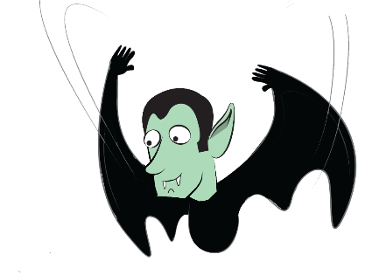
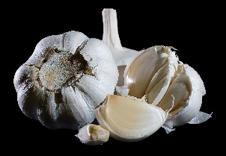
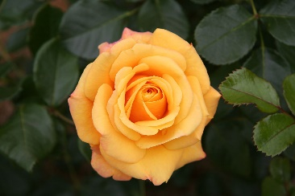
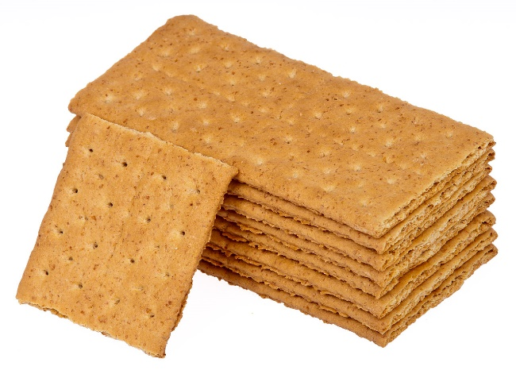
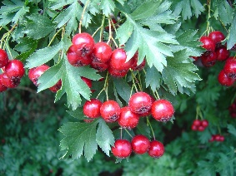
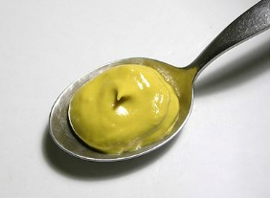
Garlic
Rose
Hawthorn
Mustard
GRAHAM

Slide 3
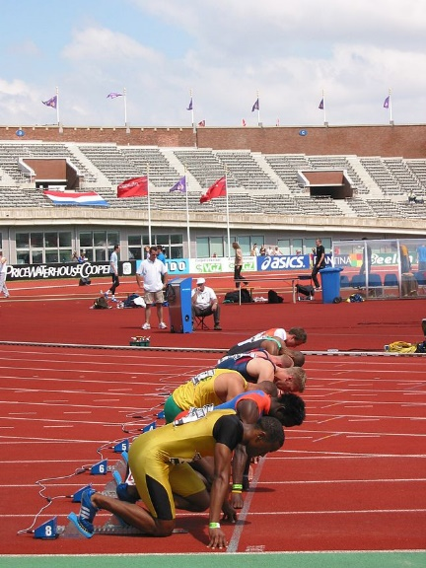
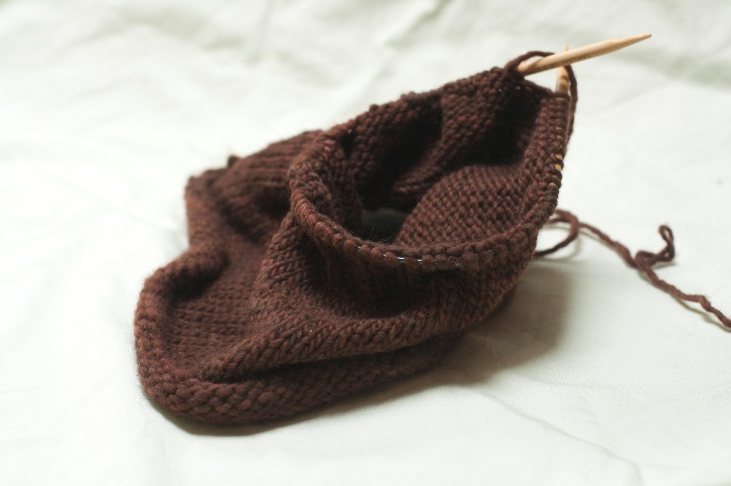
1965
11.0
75

Slide 4
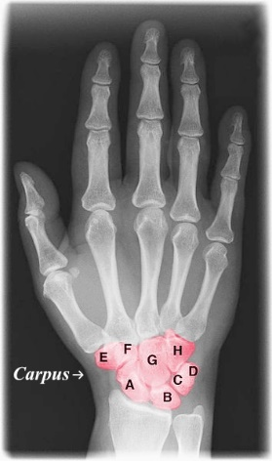
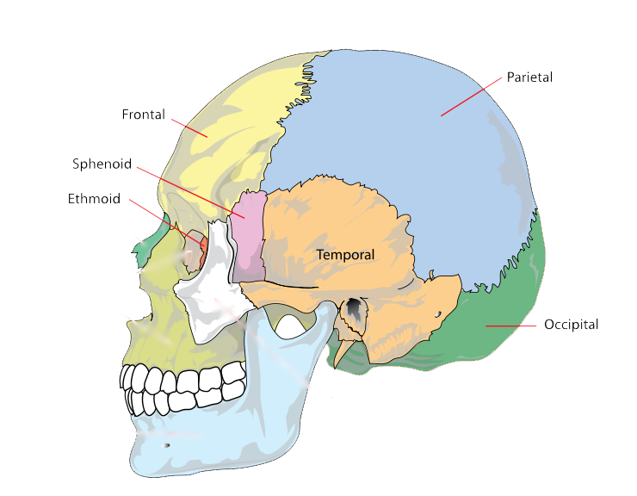
Memorable mnemonics
Some Lovers Try Positions that They Can’t Handle
A = Scaphoid B = Lunate
C = Triquetrum D = Pisiform
E = Trapezium F = Trapezoid
G = Capitate H = Hamate
Old People From Texas Eat Spiders

Slide 5
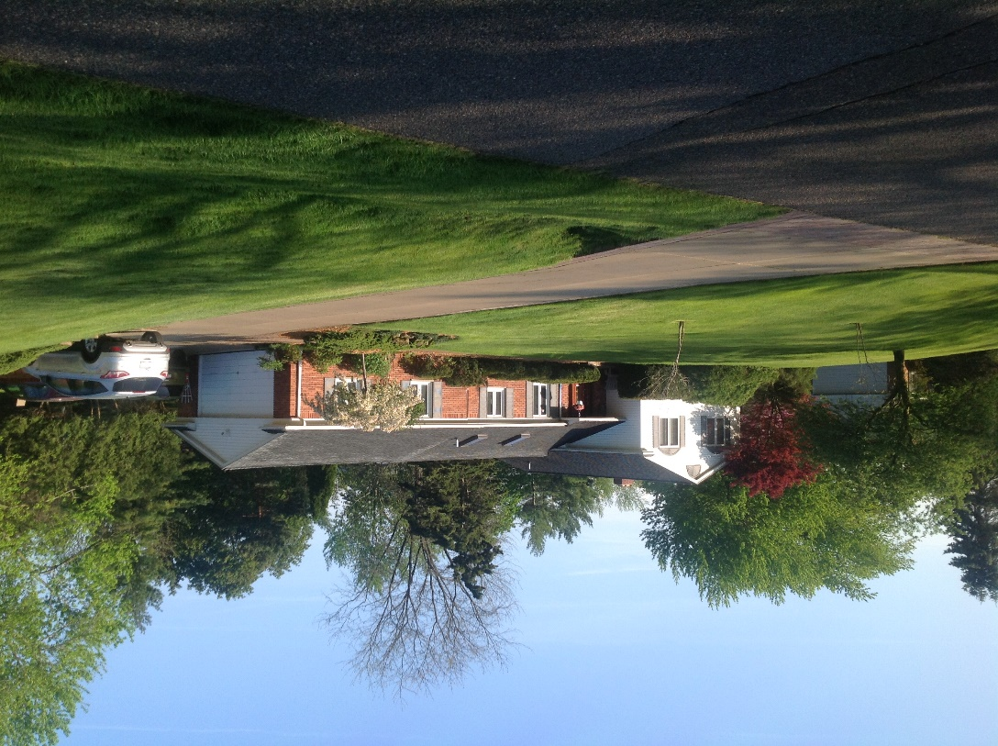
Memory palace technique

Slide 6

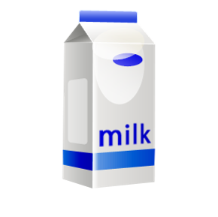

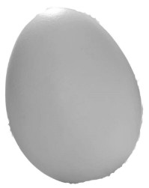

Slide 7
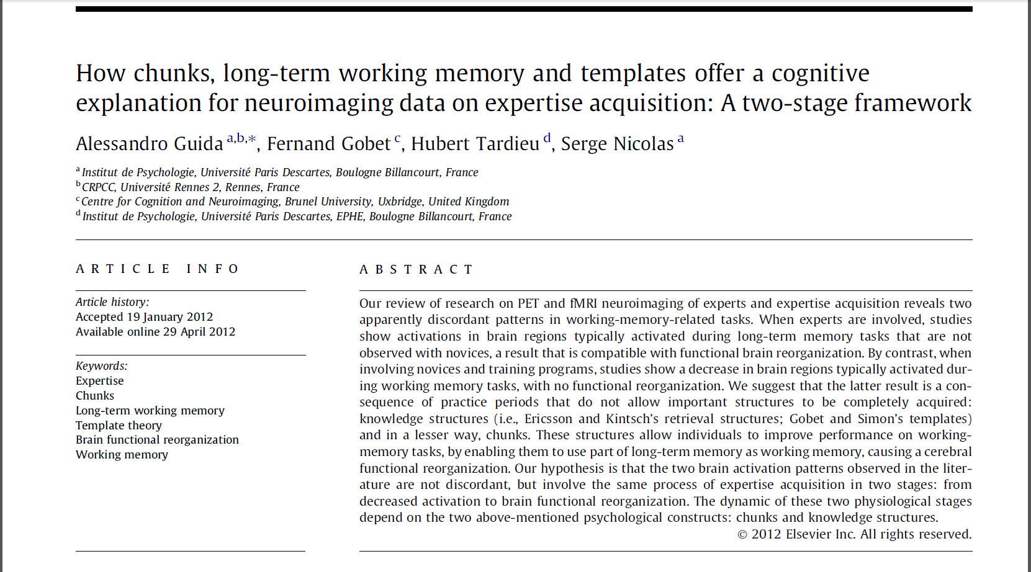
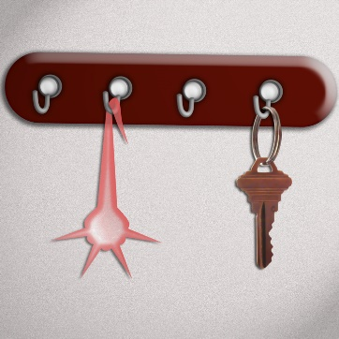

Slide 8
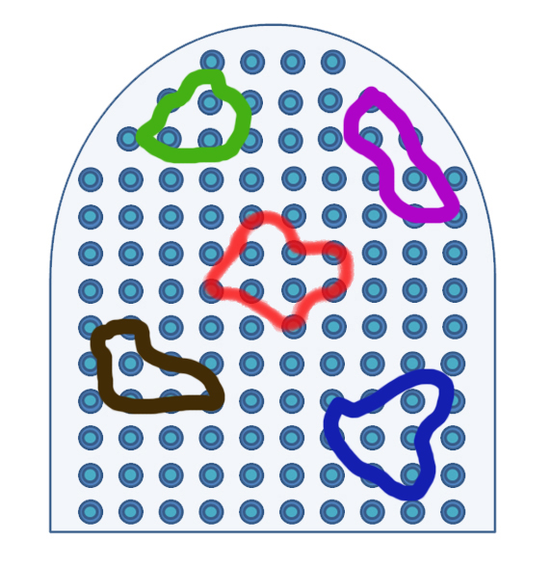

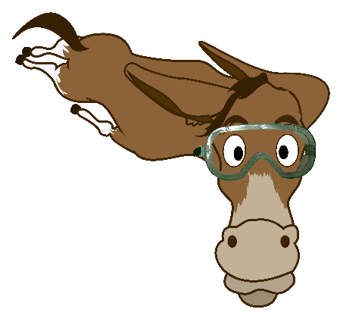
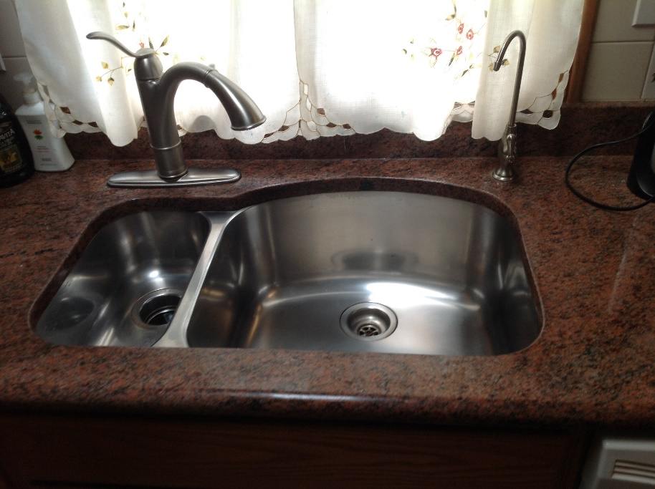
f = ma

Slide 9
Image Credits
Vampire, ©Kevin Mendez, 2014.
Garlic, by JJ Harrison (jjharrison89@facebook.com) http://en.wikipedia.org/wiki/Garlic#mediaviewer/File:Garlic_Bulbs_2.jpg.
Hawthorn, by Nadiatalent,http://en.wikipedia.org/wiki/Crataegus_ambigua#mediaviewer/File:Crataegus-ambigua-2.jpg.
Rose (Rose Amber Flush), http://en.wikipedia.org/wiki/Rose#mediaviewer/File:Rose_Amber_Flush_20070601.jpg. Graham cracker stack, by Evan Amos, http://en.wikipedia.org/wiki/Graham_cracker#mediaviewer/File:Graham-Cracker-Stack.jpg
100 meter dash, by Rudolphous, http://en.wikipedia.org/wiki/100_metres#mediaviewer/File:20070701-nk2007-100m.jpg
Knitting, ©Rachel Oakley, 2014.
Xray hand with color, by Dr. Jochen Lengerke, http://en.wikipedia.org/wiki/Carpus#mediaviewer/File:Xray_hand_with_color.jpg
Bones of the skull, LadyofHats Mariana Ruiz Villarreal, http://commons.wikimedia.org/wiki/File:Human_skull_side_simplified_(bones).svg
Layout of a house, ©Kevin Mendez, 2014.
Oakley house, ©Philip Oakley, 2014.
Living room, ©Rachel Oakley, 2014.
Guida, A., F. Gobet, H. Tardieu, and S. Nicolas. "How Chunks, Long-Term Working Memory and Templates Offer a Cognitive Explanation for Neuroimaging Data on Expertise Acquisition: A Two-Stage Framework." Brain and Cognition 79, no. 3 (Aug 2012): 221-44.
Memory ribbon and patterns, © Barbara Oakley, 2014
Flying mule, © Kevin Mendez, 2014
Kitchen sink, ©Philip Oakley, 2014.
Clip art courtesy Microsoft Corporation

Slide 10
Relevant Readings
Baddeley, Alan, Michael W. Eysenck, and Michael C. Anderson. Memory. NY: Psychology Press, 2009.
Ericsson, K.A., and R.W. Roring. "Memory as a Fully Integrated Aspect of Skilled and Expert Performance." Psychology of Learning and Motivation 48 (2007): 351-80.
Foer, J. Moonwalking with Einstein. NY: Penguin, 2011.
Guida, A., F. Gobet, H. Tardieu, and S. Nicolas. "How Chunks, Long-Term Working Memory and Templates Offer a Cognitive Explanation for Neuroimaging Data on Expertise Acquisition: A Two-Stage Framework." Brain and Cognition 79, no. 3 (Aug 2012): 221-44.
Leutner, D., C. Leopold, and E. Sumfleth. "Cognitive Load and Science Text Comprehension: Effects of Drawing and Mentally Imaging Text Content." Computers in Human Behavior 25 (2009): 284-89.
Levin, J.R., M.E. Levin, L.D. Glasman, and M.B. Nordwall. "Mnemonic Vocabulary Instruction: Additional Effectiveness Evidence." Contemporary Educational Psychology 17, no. 2 (1992): 156-74.
Maguire, E.A., D.G. Gadian, I.S. Johnsrude, C.D. Good, J. Ashburner, R.S.J. Frackowiak, and C.D. Frith. "Navigation-Related Structural Change in the Hippocampi of Taxi Drivers." Proceedings of the National Academy of Sciences 97, no. 8 (2000): 4398-403.
Maguire, E.A., E.R. Valentine, J.M. Wilding, and N. Kapur. "Routes to Remembering: The Brains Behind Superior Memory." Nature Neuroscience 6, no. 1 (2003): 90-95.
Morris, Peter E, Catherine O Fritz, Louise Jackson, Emma Nichol, and Elizabeth Roberts. "Strategies for Learning Proper Names: Expanding Retrieval Practice, Meaning and Imagery." Applied Cognitive Psychology 19, no. 6 (2005): 779-98.

